Slide 1

Green Pace
Security Policy Presentation
Developer: Caio Mauro

Slide 2

OVERVIEW: DEFENSE IN DEPTH
This policy defines the core security principles; C/C++ coding standards; authorization, authentication, and auditing standards; and data encryption standards. These standards will guide how the to approach defense in depth and create a secure non-vulnerable solution.

Slide 3
THREATS MATRIX
The highest priority threats should be prioritized, in order as fit.
The low priority threats, should not be disregarded, but take less precedence over priority threats.
Likely STD-002-CPP STD-003-CPP STD-007-CPP STD-009-CPP | Priority STD-001-CPP STD-002-CPP STD-003-CPP STD-007-CPP STD-009-CPP STD-010-CPP
Low priority STD-006-CPP STD-008-CPP | Unlikely STD-006-CPP STD-004-CPP STD-005-CPP STD-008-CPP STD-010-CPP

Slide 4
10 PRINCIPLES
Single Responsibility: Data Type
Resource Management: Data Value
Defensive Programming: String Correctness
Principle of Least Privilege: SQL Injection
Fail-Safe Defaults: Memory Protection
Fail-Fast: Assertions
Principle of Robustness: Exceptions
Resource Management: Input Output
Principle of High-Quality Randomness: Miscellaneous
Principle of Single Definition: Declarations and Initialization

Slide 5
CODING STANDARDS
1. SQL Injection: Highest risk due to potential for unauthorized access. Mitigated by input validation and parameterized queries.
2. Memory Protection: Critical due to the risk of buffer overflows and code execution. Mitigated by bounds checking.
3. String Correctness: High frequency of issues like XSS. Mitigated by proper input sanitization.
4. Data Value: Significant risk of memory leaks and data corruption. Mitigated by proper resource handling.
5. Assertions: Prevents undetected errors and silent failures. Mitigated by consistent use of assertions.
6. Data Type: Prevents type confusion and crashes. Mitigated by rigorous type-checking.
7. Exceptions: Ensures application stability by handling exceptions. Mitigated by robust exception handling.
8. Declarations: Prevents uninitialized variables and logic errors. Mitigated by compiler warnings.
9. Input/Output: Manages resource leaks and file corruption. Mitigated by proper I/O management.
10. High-Quality Randomness: Important for security, but less critical. Mitigated by using cryptographic libraries.

Slide 6
ENCRYPTION POLICIES
Encryption in rest: The concept of protecting stored data.
Encryption at flight: The concept of protecting data that is moving from its current location.
Encryption in use: The concept of protecting data that is created, edited, or otherwise defined as in-use

Slide 7
TRIPLE-A POLICIES
Authentication: The act of confirming one’s identity
Authorization: Confirming access rights and privileges of a user to secure areas.
Accounting: The process of keeping detailed track of activity while interacting with a system

Slide 8
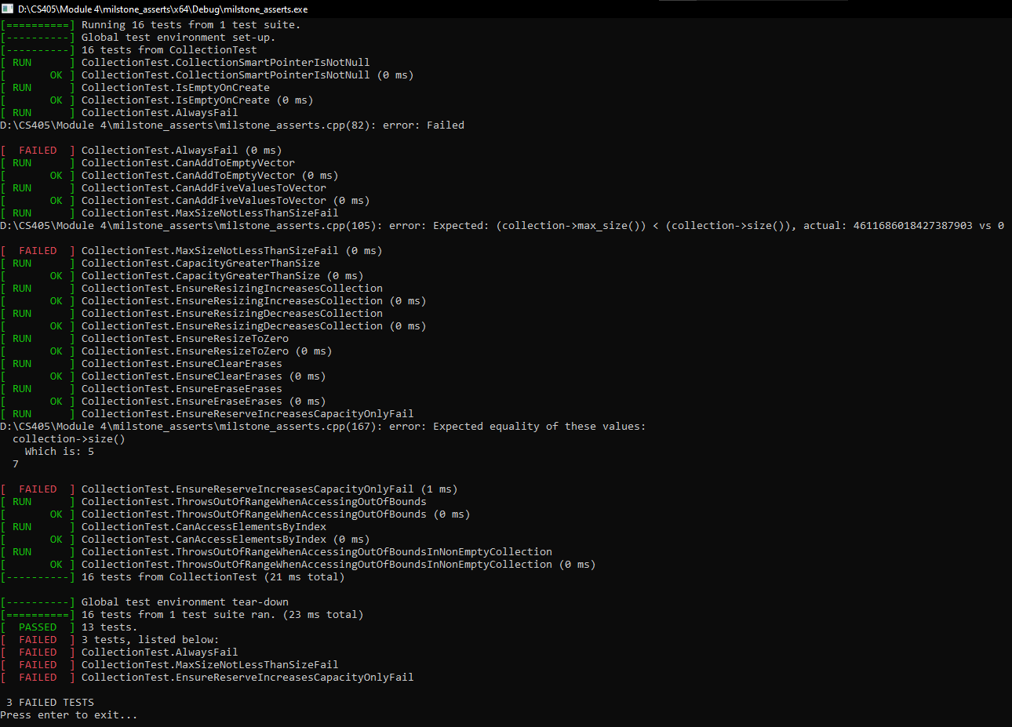
Unit Testing
These unit tests attempted to defend against SQL Injection. These checks tests a variety of things like string validation to ensure an SQL Injection attack does not work.

Slide 9

AUTOMATION SUMMARY

Slide 10
TOOLS
The DevSecOps pipeline is about integrating security practices throughout the software development lifecycle, ensuring that security is considered from the beginning rather than as an afterthought. Here’s how various tools, including Git, Cppcheck, Ghidra, OWASP, and Clang-Tidy, fit into this pipeline:
OWASP Tools: Design Phase and Pre-Production (Verify and Test)
OWASP tools, such as OWASP Threat Dragon, help in modeling potential security threats during the design phase, ensuring security is integrated from the start. Additionally, tools like OWASP ZAP are used in pre-production to perform dynamic application security testing (DAST), simulating attacks to identify vulnerabilities from an external perspective.
Git: Coding Phase
Git is crucial for version control, allowing teams to track code changes, manage branches, and facilitate peer reviews. This process ensures code integrity and allows for early detection of security flaws by making it easier to review changes and revert if necessary.
Clang-Tidy: Coding Phase and Testing Phase
Clang-Tidy is a static analysis tool and linter for C++. It's used to enforce coding standards and catch potential bugs and security issues early in development. It ensures that the code adheres to best practices and identifies potential security vulnerabilities before they progress further in the pipeline.
Cppcheck: Build Phase and Testing Phase
Cppcheck is used to perform static analysis on C/C++ code, identifying bugs, undefined behaviors, and security vulnerabilities during the build process. By integrating Cppcheck into the CI/CD pipeline, you ensure that only secure, well-tested code moves forward in the development lifecycle.

Slide 11
TOOLS
Ghidra: Testing Phase
Ghidra is typically used for reverse engineering but can be employed during testing to analyze compiled binaries. It helps in verifying that the compiled code doesn’t contain any unintended vulnerabilities, ensuring the security of the final product.
Intruder: Production Phase (Transition and Health Check)
Intruder is a penetration testing tool used to assess the security of an application before it goes live. It identifies potential vulnerabilities that could be exploited in a live environment, ensuring the application is secure during the transition to production.
Logentries: Post-Production Phase (Monitor and Detect)
Logentries automate the process of logging security-related information. This real-time monitoring helps in the early detection and response to security incidents, maintaining the security of the application in production.

Slide 12
RISKS AND BENEFITS
Pros
Proactive Risk Management: Mitigates vulnerabilities before they become critical.
Cost Efficiency: Reduces the expense of fixing security issues post-release.
Streamlined Development: Avoids disruptive, last-minute security changes.
Enhanced Security Posture: Strengthens defense with a layered approach.
Compliance Alignment: Ensures early adherence to security regulations.
Continuous Improvement: Integrates security into the development culture.
Cons
Upfront Cost: Higher initial investment in security tools and processes.
Time Cost: Increases development time due to early security integration.
Expertise Required: Demands more specialized knowledge and skills.
Added Complexity: Introduces additional layers to manage and coordinate.
Risk of Over-Engineering: Could lead to implementing more security measures than necessary, increasing complexity without proportional benefit.
The benefits of early security implementation and automation significantly surpass the drawbacks. Imagine a scenario where an attacker breaches a system and compromises user data— the damage to trust and the financial repercussions would far outweigh any initial investment. The time and expertise required are minor compared to the assurance of delivering a high-quality, secure product.

Slide 13
RECOMMENDATIONS
Develop a Clear Response Plan: Establish a well-defined incident response plan for post-production, including roles, procedures, and communication strategies to ensure swift action when security incidents occur.
Formalize Repository Vetting Process: Create a standardized process for selecting and vetting repositories during the build phase to ensure that all dependencies and tools are secure and trustworthy.
Define Roles and Responsibilities: Clearly outline the roles and responsibilities for enforcing security policies across all phases, ensuring that there is accountability and clarity on who is responsible for what.
Regular Policy Audits: Implement regular audits of security policies and their enforcement to ensure that they are being followed correctly and effectively across all stages of the pipeline.
Continuous Training and Education: Provide ongoing security training for all team members to ensure that they are up-to-date with the latest security practices and capable of effectively implementing and enforcing policies.

Slide 14
CONCLUSIONS
Use Correct Integer Precisions: Avoid issues with overflow and underflow by ensuring that integer types are appropriate for their intended use.
Handle All Exceptions: Ensure that all errors are managed to prevent application crashes and unhandled security vulnerabilities.
Validate Input Data: Protect against injection attacks and ensure data integrity by rigorously checking all user inputs for correctness and safety.
Sanitize Data: Remove or encode harmful input to prevent security breaches and ensure that data is safe for processing or storage.
Default Deny: Restrict access and permissions by default, allowing only explicitly permitted actions to enhance overall security and reduce risk.

